Slide 1

A PARIS-PROOF RETAIL PROPERTY SECTOR:
How to reach net-zero shopping spaces by 2050?
28/10/2021
BPIE

Slide 2
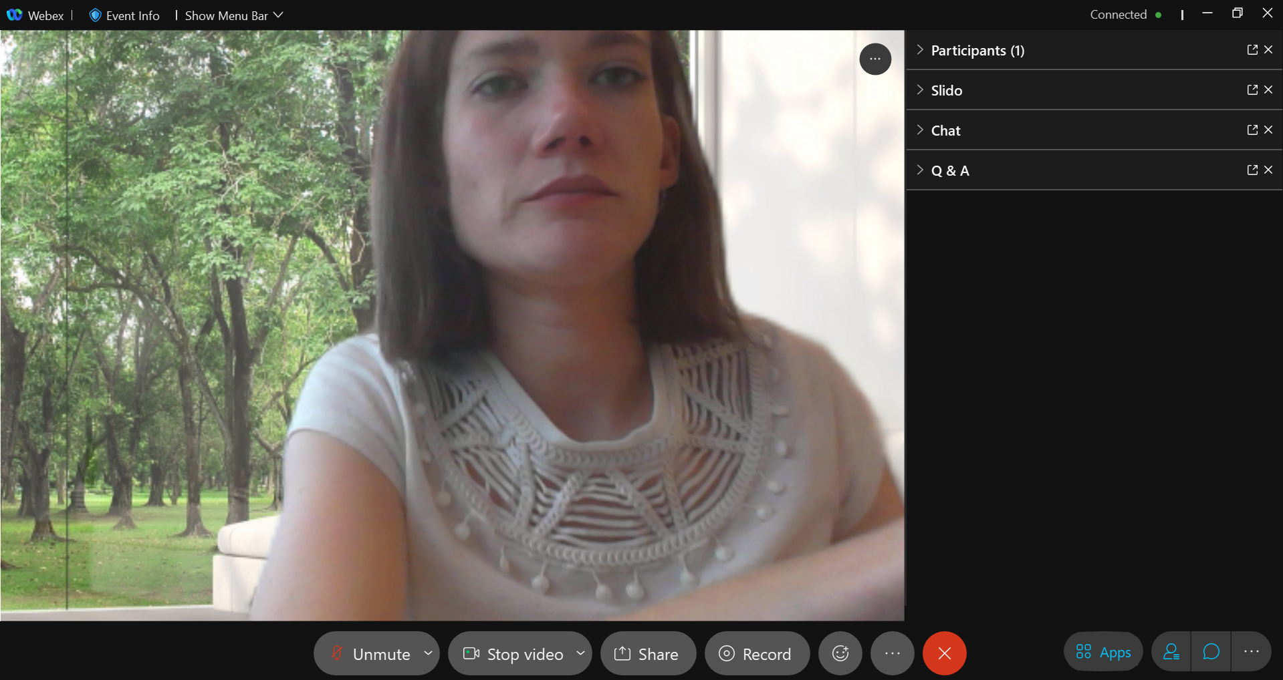
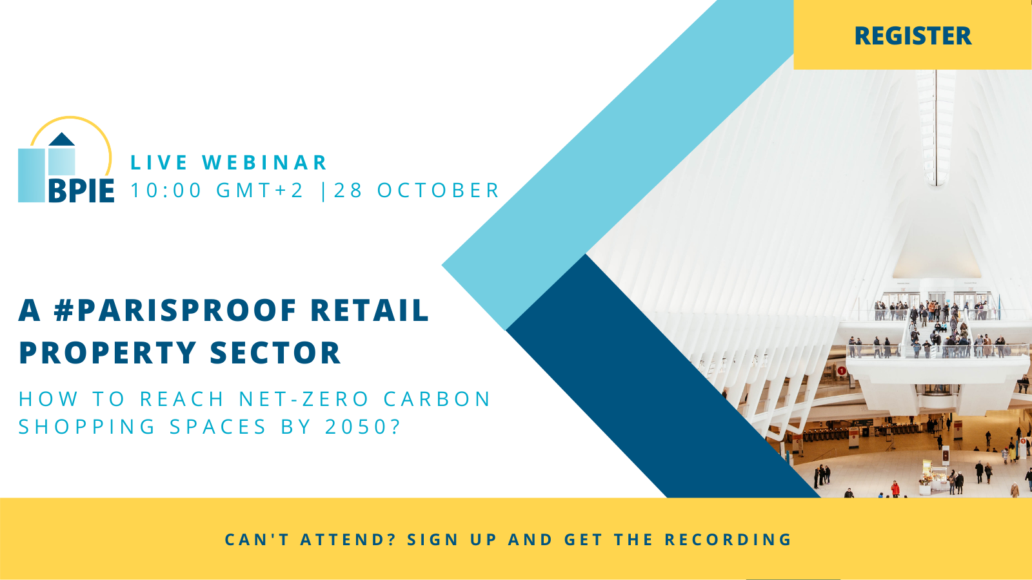
HOUSEKEEPING
Use Slido to answer polling questions
Submit your text questions and comments using the Q&A panel
Avoid use of chat!
Today’s presentation is being recorded and will be provided within 48 hours, along with the slide deck.
28/10/2021
A #ParisProof Retail Property Sector

Slide 3
Agenda
A #PARISPROOF RETAIL PROPERTY SECTOR
Opening remarks
Clemens Brenninkmeijer, Head of Sustainable Business, Redevco B.V.
Keynote
Stefan Moser, Head of Unit, Coordination of the Just and Green Energy Transition,
Directorate-General for Energy, European Commission
BPIE report launch
"Paris proof retail real estate: Who needs to do what and by when? A vision and policy
roadmap towards decarbonised retail buildings"
Zsolt Toth, Senior Project Manager, BPIE
Q&A
28/10/2021
A #ParisProof Retail Property Sector

Slide 4
Agenda
A #PARISPROOF RETAIL PROPERTY SECTOR
Panel discussion followed by Q&A with the audience
Paris-Proof retail success stories:
Challenges and solutions to achieving a zero-carbon retail building portfolio
Guido den Teuling, Sustainabilty Manager, Redevco B.V.
Simona Portigliotti, Director of Marketing, Communications, CSR & Innovation, NHOOD
Louise Ellison, Chief Commercial Officer, Longevity Partners
Franco Hauri, Senior Investment Manager, Energy Efficiency Fund, Aquila Capital
Closing remarks
Joost Koomen, Secretary General, ECSP – European Council of Shopping Places
28/10/2021
A #ParisProof Retail Property Sector

Slide 5
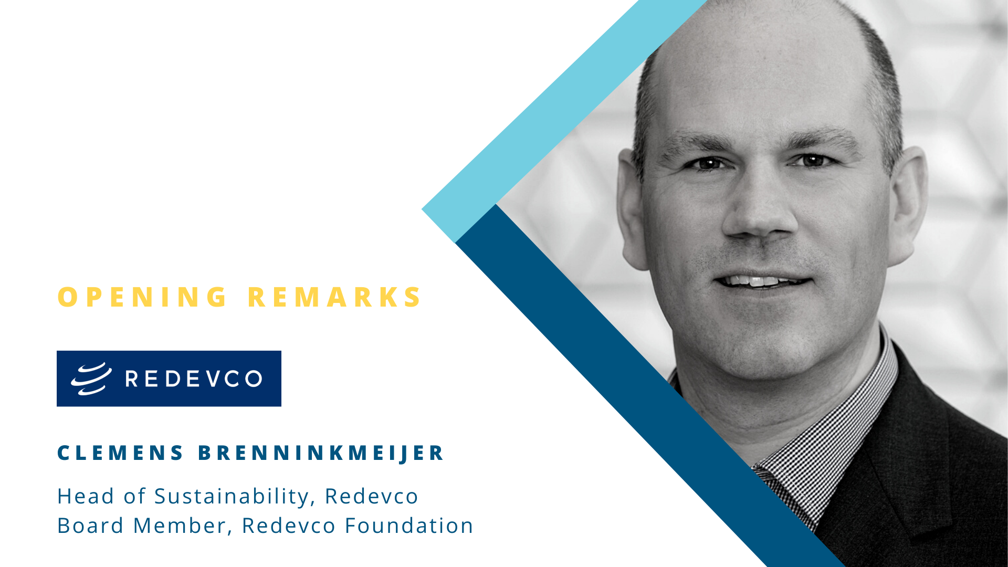

Slide 6
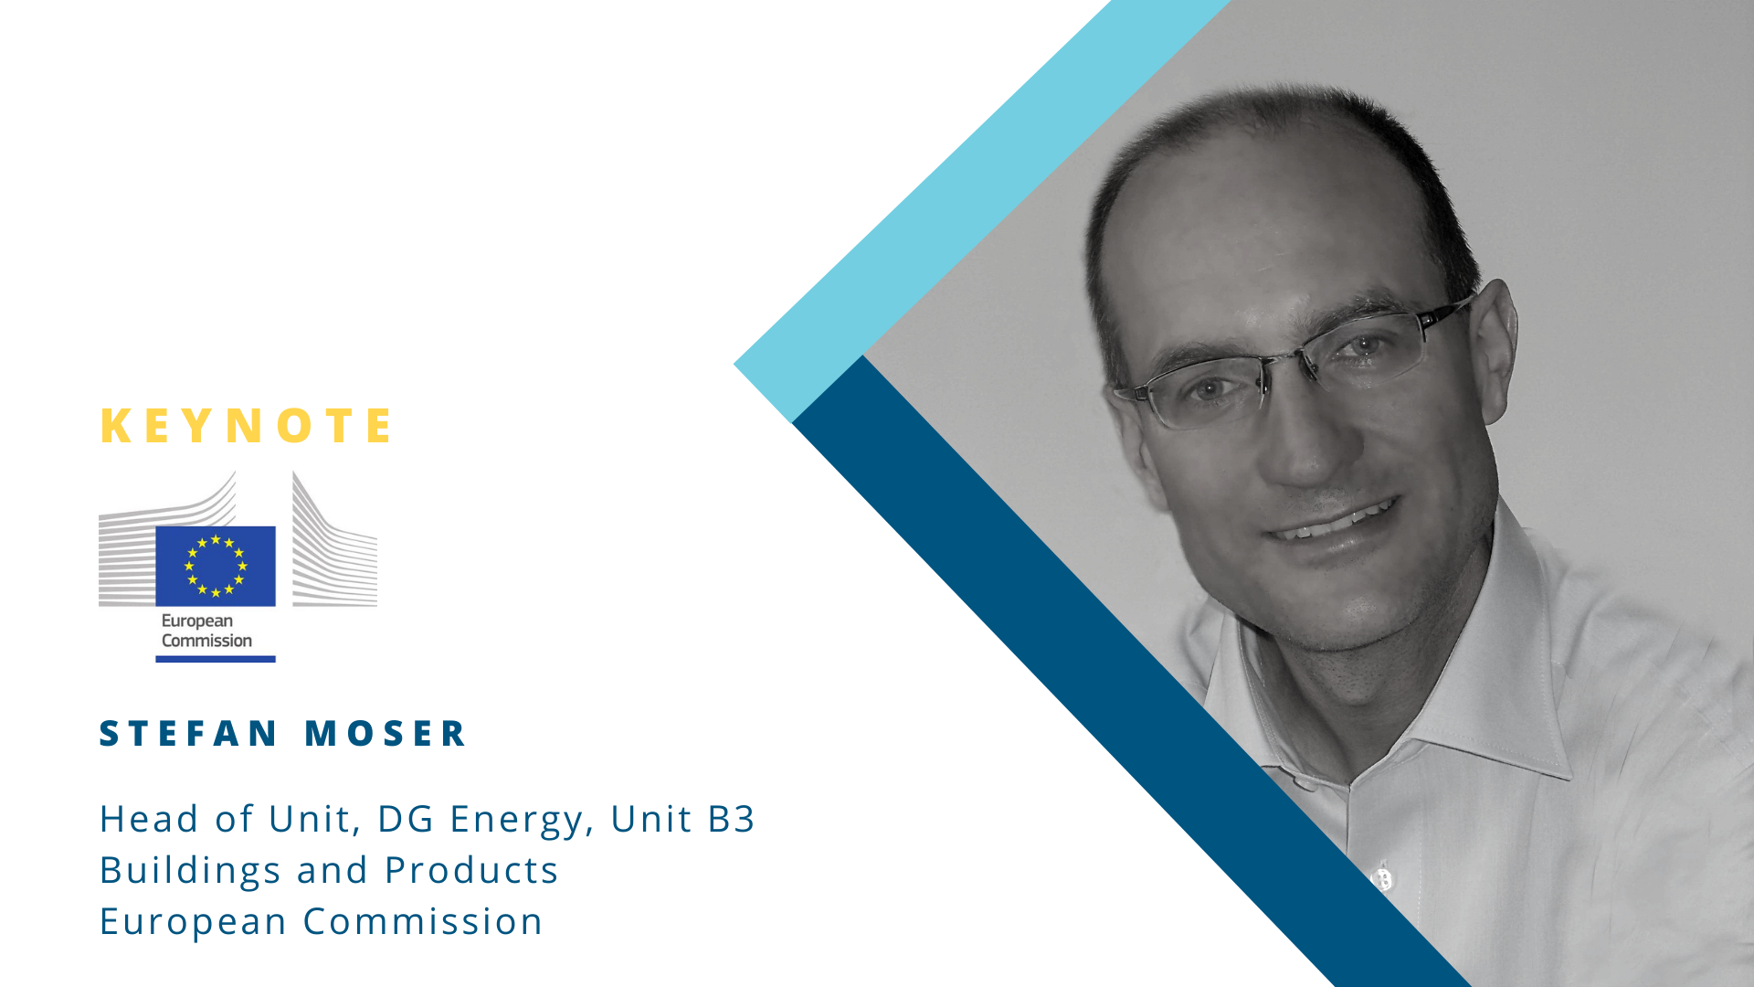

Slide 7


Slide 8
A PARIS-PROOF RETAIL REAL ESTATE SECTOR:
A vision and roadmap for decarbonised retail property
28/10/2021
Zsolt Toth

Slide 9







What we do
BUILDINGS PERFORMANCE INSTITUTE EUROPE
EUROPEAN
NON-PROFIT
THINK-TANK
POLICY ADVICE ON BUILDING REGULATION, FROM DESIGN TO IMPLEMENTATION
BRUSSELS
AND
BERLIN
INDEPENDENT RESEARCH
IMPROVING THE ENERGY PERFORMANCE OF BUILDINGS ACROSS EUROPE
IN OPERATION SINCE 2010
28/10/2021
A #ParisProof Retail Property Sector
Notes:
Independent think-thank and repository of building related policy expertise
Our mission to decarbonise the built env, RRE will have a particular role

Slide 10
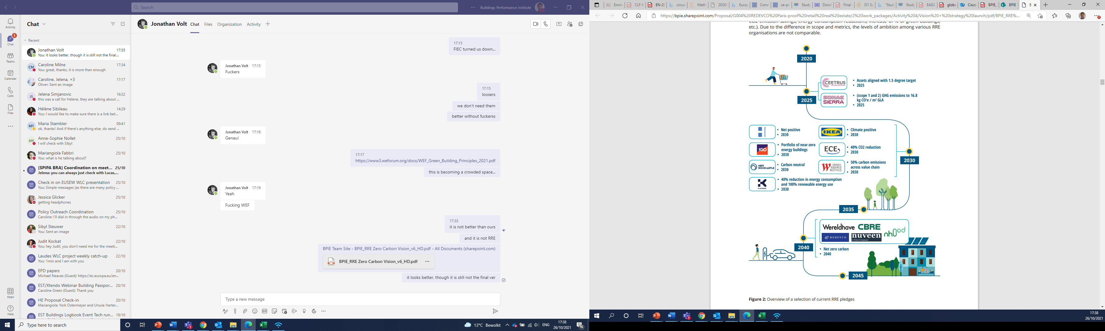


COMMITMENTS TO TRANSITION TO
A NET-ZERO WORLD
Ambitious pledges, but also a diversity in scope, metrics and ambition.
28/10/2021
A #ParisProof Retail Property Sector
Notes:
When embarking on this project and assessing the status quo, we were really pleased to notice ambitious pledges already in place.
Two critical gaps remain. First, there is still no single framework for assessing alignment across the RRE sector. This can make it especially difficult to navigate and compare. Second, it is not just about climate alignment: we still have to see how climate alignment targets may translate to strategy, governance, risk management.
The next step for delivering against
these commitments, however, remains somewhat
unclear for many. This lack of clarity is not due
to a lack of guidance. There are many industry
bodies globally that have provided excellent targets,
benchmarks, and guidance documents on how
to deliver elements of net-zero carbon. The piece
that is missing is a common understanding of what
is meant by net-zero carbon in real estate and a
common framework outlining the steps to deliver
an overarching net-zero carbon strategy.

Slide 11

MISSION IMPOSSIBLE
The vision for a decarbonised RRE sector means buildings and portfolios must achieve zero carbon throughout their lifecycle, including development, refurbishment and operation. The construction of new buildings and renovation of existing assets will need to happen without further depleting our carbon budget.
28/10/2021
A #ParisProof Retail Property Sector
Notes:
A common understanding of the targets, such as the term net-zero carbon, and a shared vision should incentivise consistent and long-term action, as well as send a clear and credible signal to investors, policymakers and the public

Slide 12
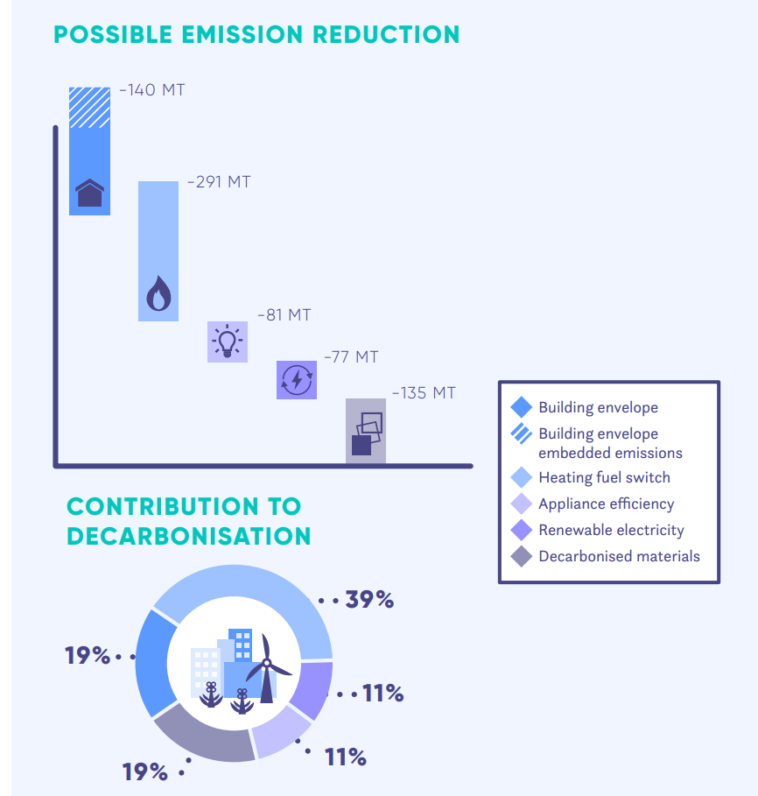
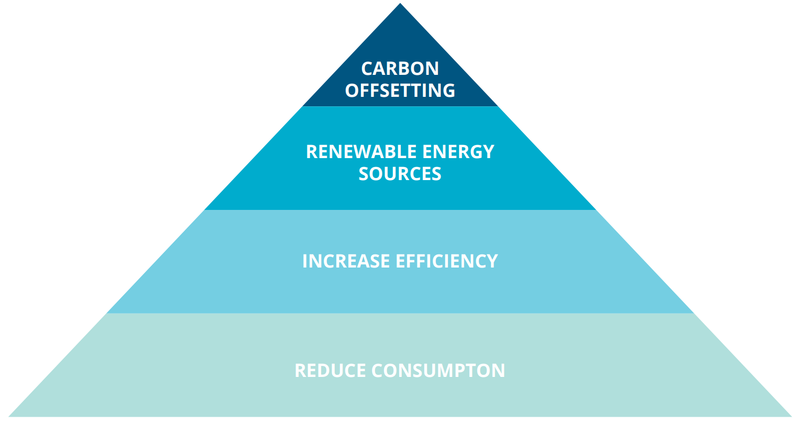
DEFINING NET ZERO CARBON
← net reduction potential of different areas, based on EU Calc
Overall strategy to reach net zero carbon
28/10/2021
A #ParisProof Retail Property Sector
Notes:
net-zero carbon means that your company or your assets, on average, puts no emissions into the atmosphere.
A number of market initiatives are in place: WGBC

Slide 13
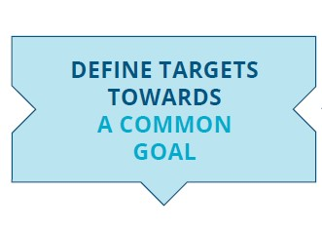

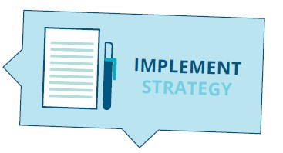
CHECK LIST FOR NET ZERO CARBON RRE
CO2 targets for new and existing buildings
Targets on how to reduce operational and embodied emissions
Develop long-term, step-wise plans
Monitor and revise targets for 2025, 2030, 2040, and 2050
Consider all relevant emissions
Lead by example
Define what net zero carbon means, including the scope and potential loopholes
Set up transparency and MRV mechanisms
28/10/2021
A #ParisProof Retail Property Sector

Slide 14




Industry actions
THE PATHWAY TO ZERO-CARBON
Make the carbon-related risks and benefits more tangible by robust and detailed analysis of the impacts of intervention strategies and retrofit solution
Make sure that wider multiple benefits of investing in low-carbon solutions, including to indoor climate, comfort and health, are also accounted for, since these are increasingly relevant to meet customers’ expectations as they return to shopping centres
Improve the collection, disclosure and sharing of data; integrate energy, carbon and financial performance datasets
Align incentives between retail building owners and tenants in terms of data sharing and sustainability goals
28/10/2021
A #ParisProof Retail Property Sector

Slide 15




What is needed from policy makers
THE PATHWAY TO ZERO CARBON
Follow up enforcement of EPC and NZEB regulations by EU Member States with the clear objective of converging towards net zero energy and net zero carbon targets
Introduce policy roadmaps to a carbon neutral building stock, including specific requirements for different sectors
Support data collection efforts by clarifying data collection and sharing obligations among retail stakeholders (e.g. landlord-retailer).
Introduce minimum mandatory requirements and building codes based on carbon performance in addition to those based on operational energy.
28/10/2021
A #ParisProof Retail Property Sector

Slide 16
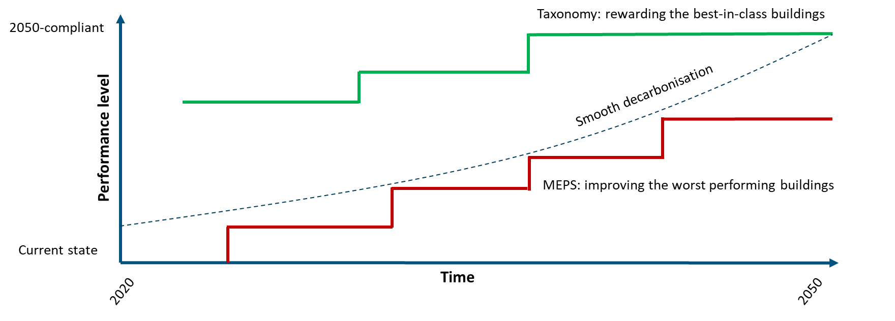
DECARBONISATION PATHWAY
AND POLICY LANDSCAPE
28/10/2021
A #ParisProof Retail Property Sector
Notes:
Most important policy levers influencing the decarbonisation agenda will be:
The EU sustainable finance taxonomy by tying financing conditions to carbon emission of the asset (carbon neutral assets enjoying preferential financing conditions, whereas assets with high emissions facing the risk of limited availability of finance. This trend will be more visible as financial institutions will be requested to disclose Green Asset Ratio which incentivize financing only of green assets.
MEPS setting the thresholds under which assets that can no longer be placed on the market (-> stranded assets)

Slide 17
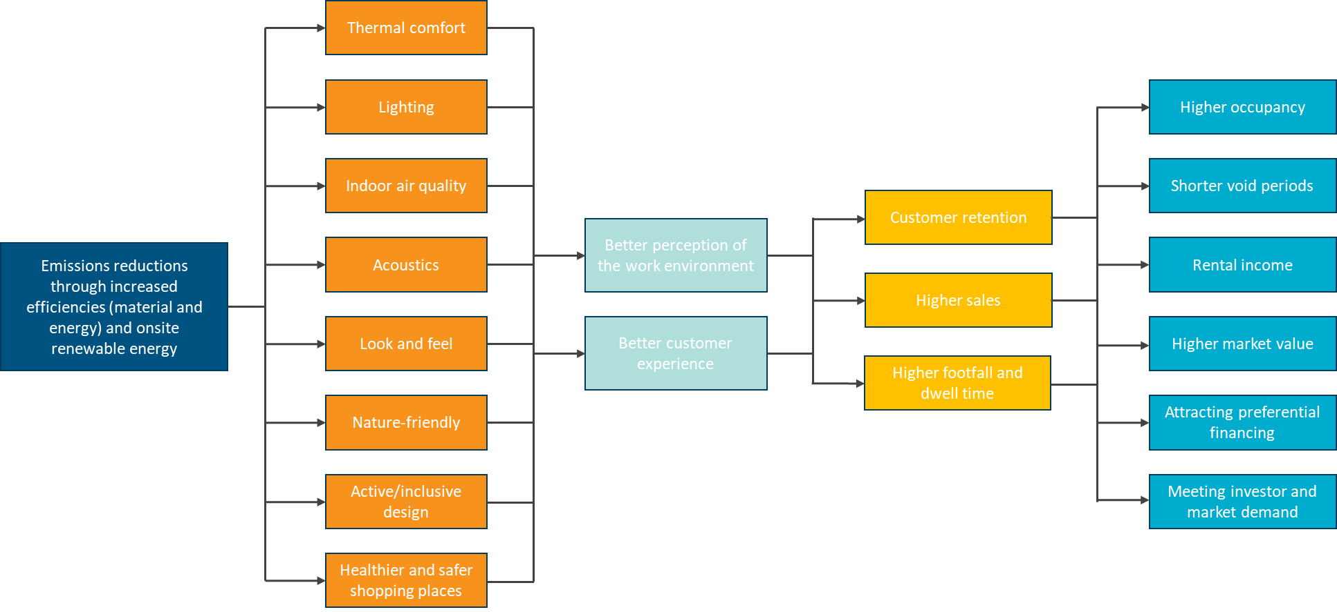
MAKING THE BUSINESS CASE
28/10/2021
A #ParisProof Retail Property Sector
Notes:
While green buildings are increasingly recognised by the market as being more valuable, delivering net-zero carbon is a financial commitment. It requires further investment and improvement. One of the first
questions companies will often ask is “Who pays?”
There are a number of benefits associated with low carbon buildings, such as reduced costs of energy for occupier, reduced carbon, regulatory risk and meeting investor demand for landlord. The way how these benefits translate into added value is still somewhat a highly debated topic. What certainly helps is if energy efficiency and carbon mitigation measures are coupled with these additional building features, i.e. that these credentials are simultaneously targeted, implemented, measured and communicated in a clear way. This slide illustrated how the impact chain can be mapped and translated.

Slide 18
CONCLUDING THOUGHTS
Equitable cost and benefit sharing
Landlord/tenant engagement plan
Skills and capacity building
Looking beyond risk management
Looking beyond carbon: environmental and social benefits
28/10/2021
A #ParisProof Retail Property Sector
Notes:
Following from the previous slides, it is important that the costs and benefits are shared in a fair way. Split incentives have been notorious for making investment in retail buildings difficult. Having a landlord/tenant engagement plan should be part of the zero carbon strategy. Aligning interests and objectives – no one can do this alone.
Skills and capacity – empowering asset managers to engage with retailers, whole life carbon accounting. ESG management. Discrepancies between small and larger actors – need to take everyone with us.
Beyond risk management: over the last decade, climate-related risks have been one of the main entry points to engage the financial and real estate sectors on Paris alignment. Physical climate risk and carbon risk are the obvious impacts on the mind of RRE owners and operators, with the risk of stranded assets being the most acute risk that is on the mind of RRE owners. Divesting from assets which face high carbon or regulatory risks may reduce the exposure of the portfolio, but this in itself will make no contribution to reducing carbon emissions. Need for a more proactive role of explicitly targeting climate goals.
Leadership in climate mitigation is an opportunity to (re)build a greener and a more resilient RRE sector. As part of its climate alignment efforts, the sector will create sustainable places and contribute to maintaining the social fabric. Focus should also be on good quality and healthy buildings that meet evolving user needs and stimulate a more equitable and sustainable consumer culture.

Slide 19
Thank you!
More information here:

Slide 20
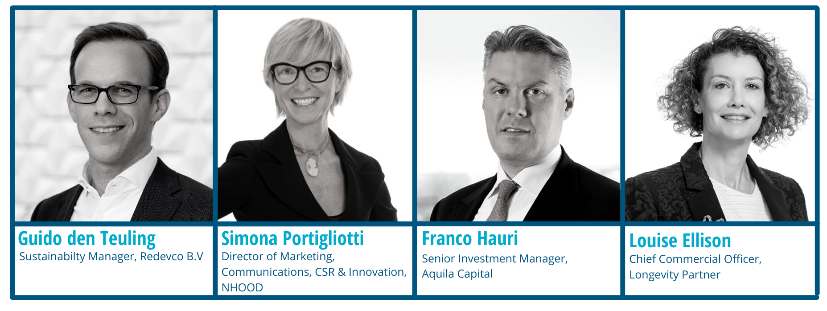
PANEL DISCUSSION
28/10/2021
A #ParisProof Retail Property Sector

Slide 21


Slide 22
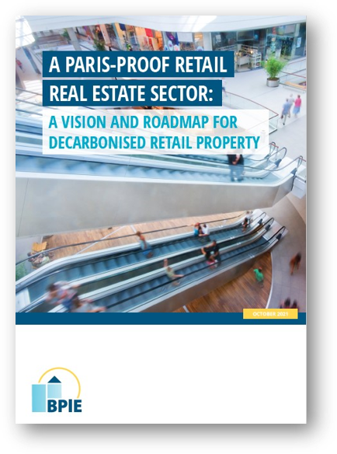


A vision and roadmap for decarbonised retail property
A PARIS-PROOF RETAIL REAL ESTATE SECTOR
Slides, recording and publication will be sent by email within 24 hours of this webinar
RRE Vision and Roadmap is now available for download at BPIE website - www.bpie.eu
Please share it and spread the word! Tag @BPIE_eu and hashtag #ParisProofRRE
28/10/2021
A #ParisProof Retail Property Sector

